Slide 1
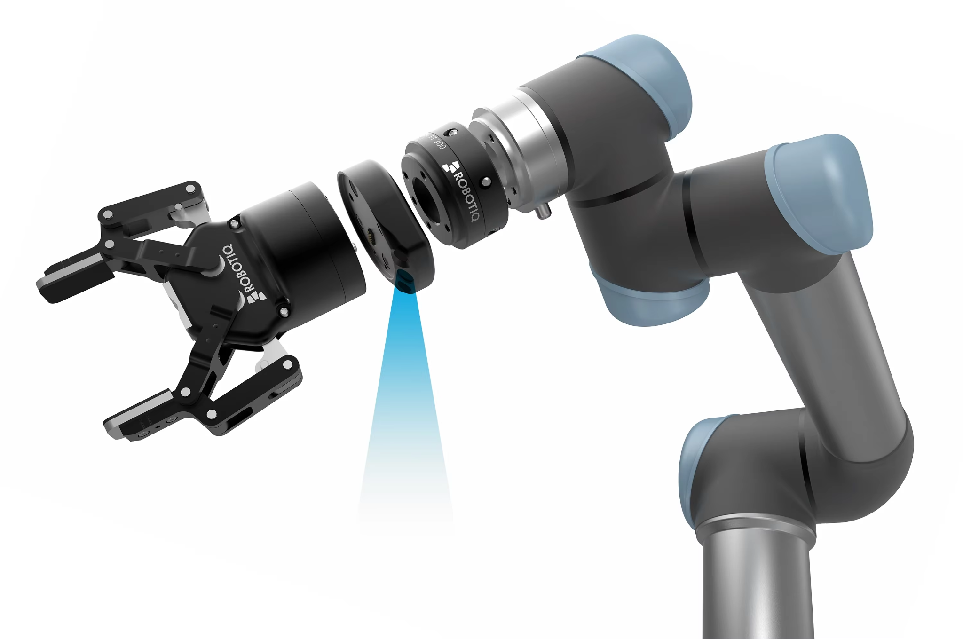
Robo Matcha : A Reliable , Human-Independent Matcha System
Presented By
Aarti G , Kritika S, Nivrithi V , Pragya C and Yashaswini M
Instructor
Dr Behin Elahi

Slide 2
Introduction
Humans: “I’ll make it the same every time.”
Reality: one day it’s foam, next day it’s soup, sometimes it’s… spinach water.
So we gave the job to a robot arm and said:
“Just make perfect matcha. Every. Single. Time.”
Then we discovered: even robots can mess up and make lumps if we let them play with too many settings.
Our mission:
Make the robot more robust (no drama, no lumps).
Depend less on humans yelling “STOP, TOO MUCH MATCHA!”.
Use ISE 222 tools (Systems Engineering, MBSE, FTA, FMEA, Reliability, Queueing, LTV/CAC) to fix it like serious engineers.

Slide 3
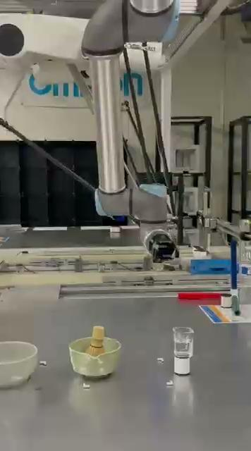
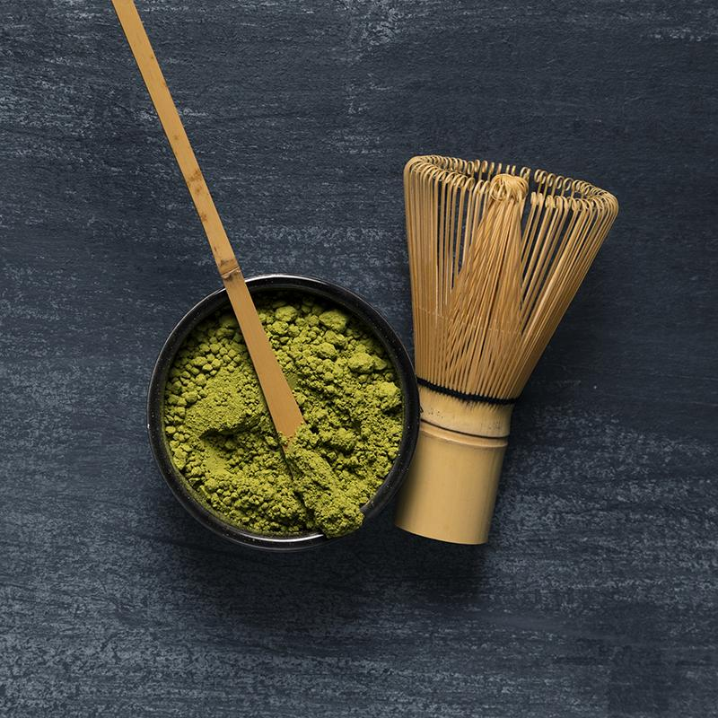
OuR Robot Making Vanilla Iced Matcha

Slide 4
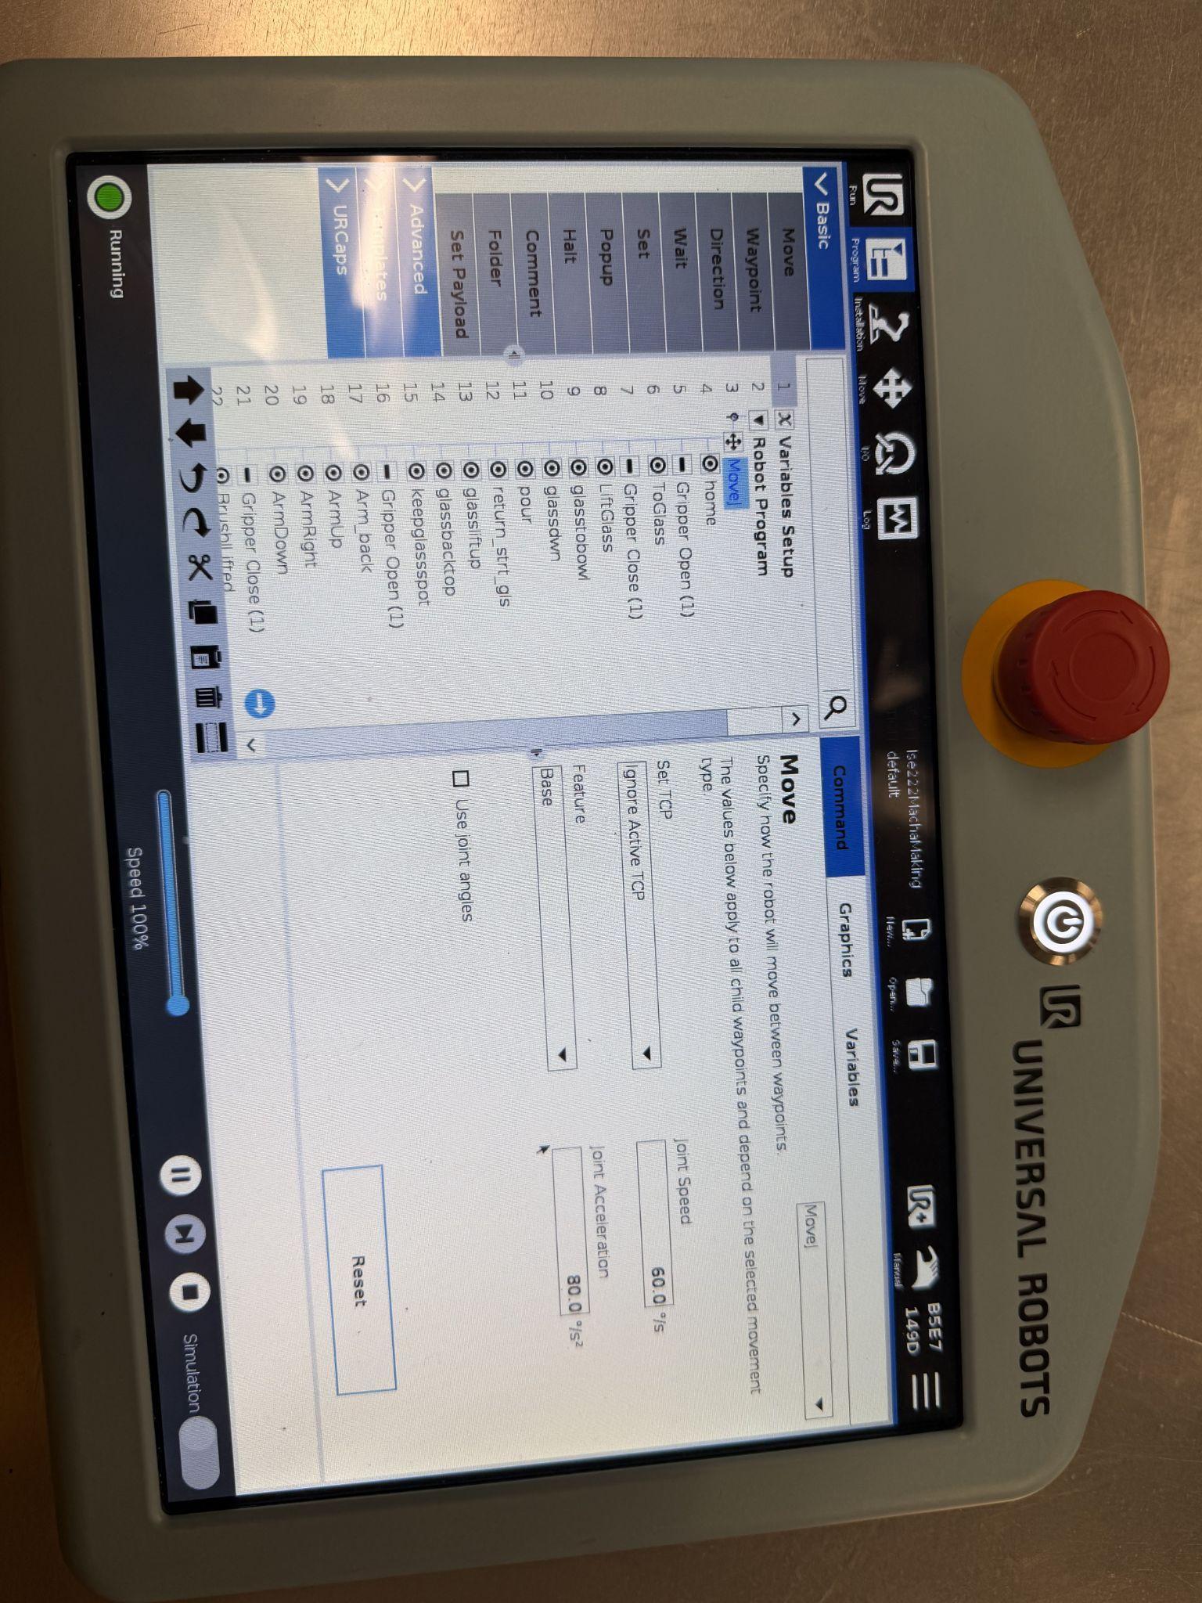
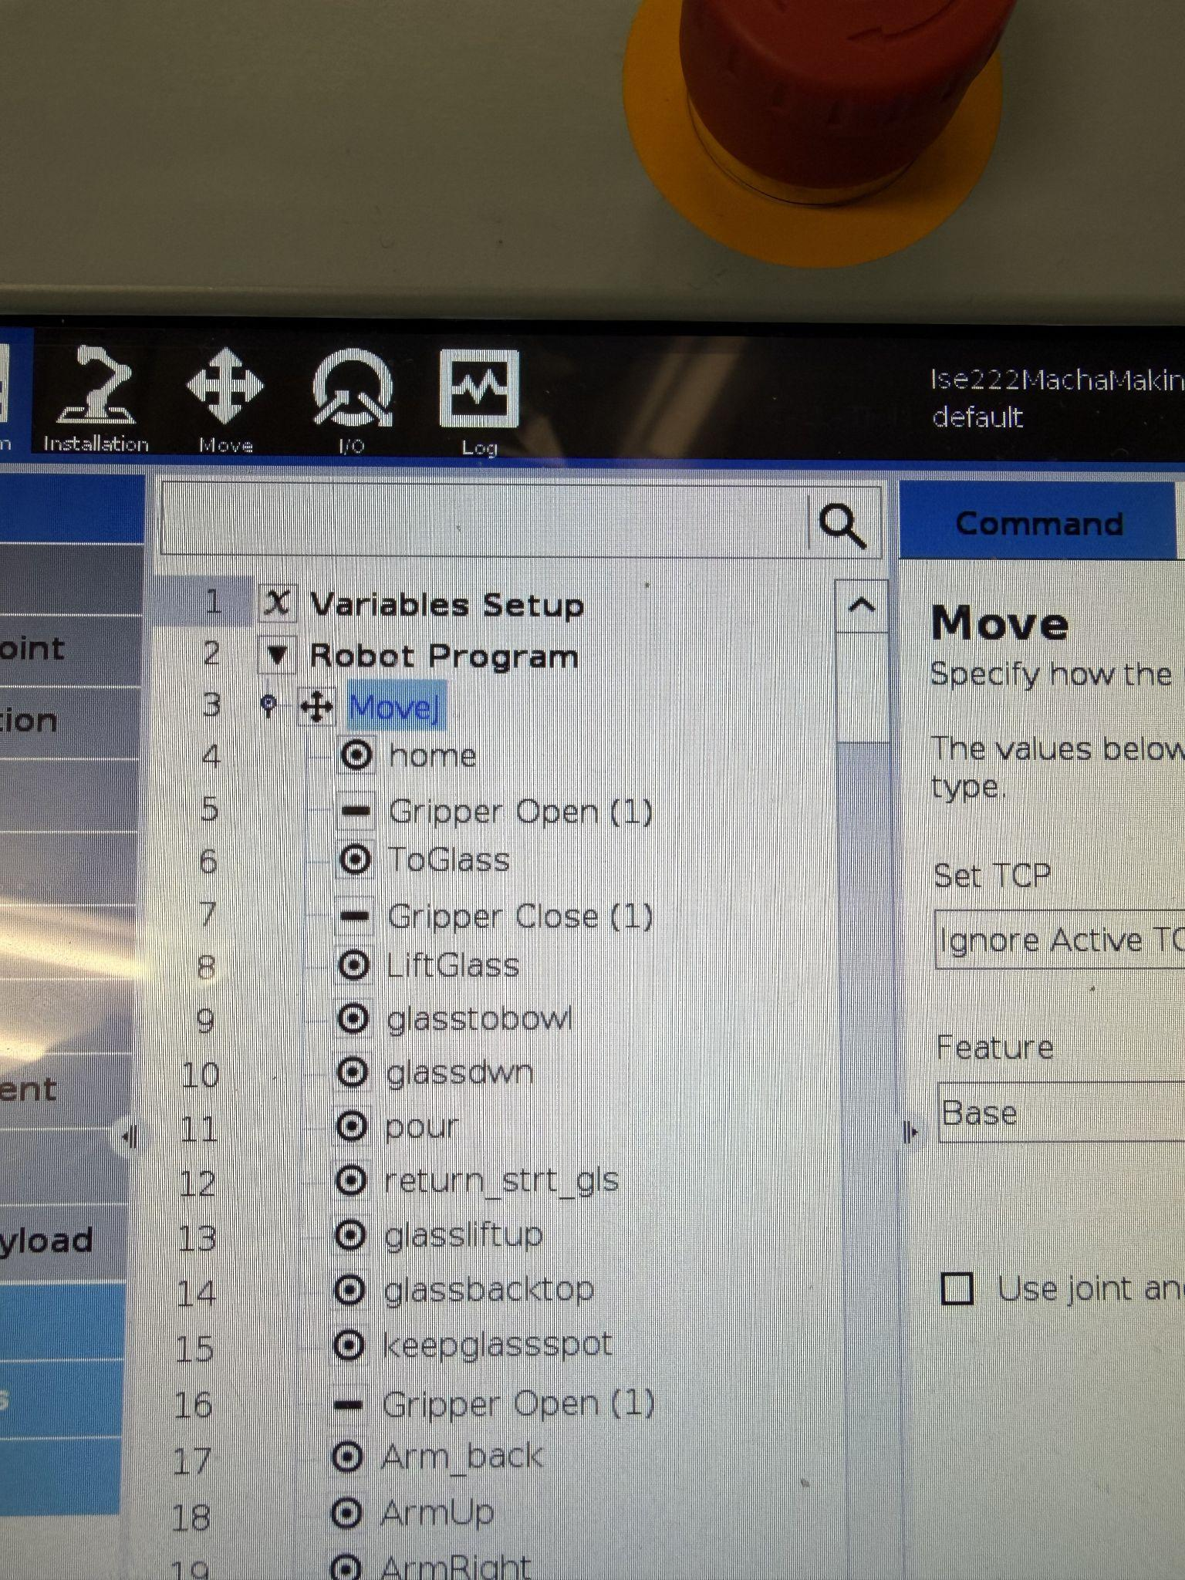
Configurations and setup for Robo Matcha

Slide 5
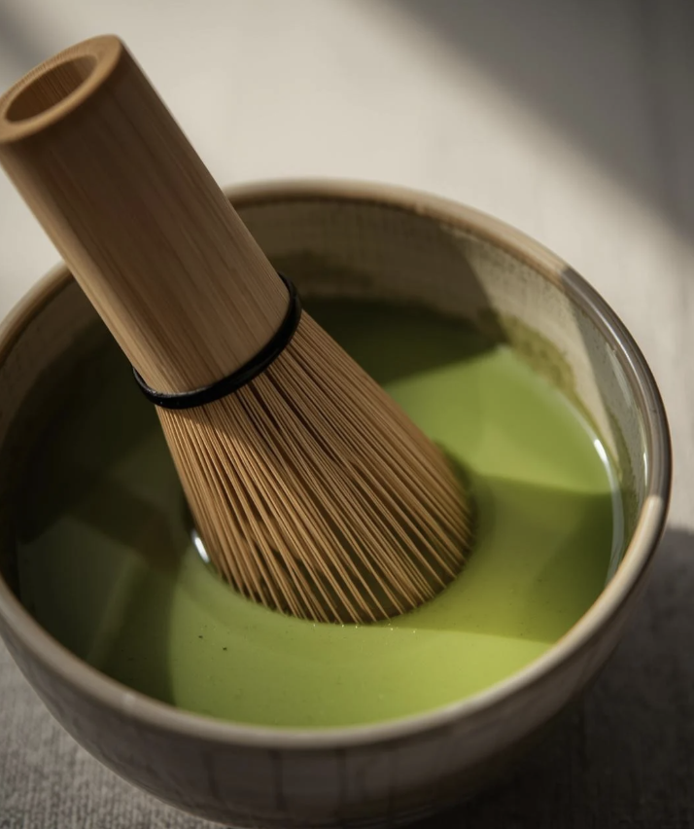
Table of Contents
Introduction
Matcha Making
Universal robot UR10e
Literature Survey
System Engineering
MBSE
Axiomatic Design & Fishbone Analysis
Fault Tree Analysis
Optimized Linear Program
LTV and CAC
FMEA
Reliability, Maintainability and Queueing
Integrated Results
Conclusion
Future Work

Slide 6
Universal robot UR10e
Reach & Payload for Café Tasks
UR10e’s 1300 mm reach and 12.5 kg payload let it handle bowls, kettles, and tools in a larger café workspace without repositioning the robot.
High Precision for Consistent Matcha
With 6 DoF and ±0.05 mm repeatability, the arm can follow the same whisk path, angle, and depth every time which is critical for foam, texture, and no-lump consistency.
Collaborative & Compact in Front-of-House
As a collaborative cobot with built-in safety functions and a small footprint, UR10e can work near customers and baristas at the counter, instead of being locked in a cage.
Fast Setup of Recipes & Motions
The touchscreen, drag-and-drop programming and UR+ accessories make it easy to teach whisk motions, dosing positions, and future drink recipes without heavy coding.
Operational Efficiency for LTV/CAC
Low power usage, easy redeployment, and reliable operation reduce running costs and downtime supports a better LTV/CAC ratio when we compare robot barista vs human barista.

Slide 7
LITERATURE SURVEY
No | Year | Paper | Key Focus | Project Summary
1 | 2011 | Learning to Pour with a Robot Arm | Robot learns liquid pouring using goal + shape learning (DMPs) to get stable, repeatable trajectories. | Supports our robot motion design for whisking matcha with consistent trajectories instead of “random” arm paths.
2 | 2020 | Stir to Pour: Calibration of Liquid Properties | Robot first stirs to infer liquid properties, then adjusts pouring to reduce spillage and error. | Inspires using whisking as a sensing step (viscosity proxy) before final pour, to tune recipes and reduce failures (lumps).
3 | 2005 | Japanese Green Tea Robot “T-Bartender” | Early tea-serving robot that automates Japanese green tea preparation while preserving ceremony. | Shows prior work on tea robots, we extend this idea with matcha and add data-driven quality metrics (consistency labels).
4 | 2025 | Robotic Optimization of Powdered Beverages | Uses computer vision + Bayesian optimization to maximize foam/texture quality of powdered drinks. | Directly motivates our matcha quality optimization (perfect consistency) using sensor feedback and experimental design.
5 | 2023 | Human Factor in Coffee Reproducibility | Quantifies how barista technique affects reproducibility across coffee brewing methods. | Provides baseline that humans introduce variability, we use it to argue why a robot can reduce variability in matcha prep.

Slide 8
Systems Engineering and MBSE

Slide 9
SYSTEM ENGINEERING
System-of-interest & Goal
System: Semi-Automated Matcha Preparation System with UR10e Robot Arm
Prepares a bowl of matcha with manual powder dosing and bowl placement, followed by automated water dispensing and whisking using UR10e collaborative robot.
Stakeholders
Customer / drinker: taste, texture, appearance consistency.
Barista / Operator: Easy operation, minimal training, intuitive interface, quick cycle time.
Café Owner: Throughput, cost efficiency, reliability, maintenance requirements, space utilization.
Maintenance Technician: Accessibility for cleaning, diagnostic capabilities, spare parts availability, simple troubleshooting.
Safety / Regulator: Hygiene standards (food safety), electrical safety, collaborative robot safety (ISO/TS 15066), operational safety protocols.
System Boundary & Context
Inside the system:
Water dosing module
Matcha powder input point (manual funnel/guide with alignment markers)
Whisk module (UR10e robot arm )
Bowl handling fixture (manual placement holder with centering mechanism)
Controller (UR10e control cabinet subsystem coordination)
HMI (start/stop buttons + emergency stop + status display / touch screen)
Power supply and electrical distribution
Safety system (emergency stop circuit, force limiting, safety zones)
Outside the system:
Human operator (manually adds measured matcha powder, places bowl in fixture, presses "Start" button, removes finished matcha)
Utilities (water supply, electrical power 230V AC, drainage)
Ambient conditions (room temperature 18-25°C, humidity, lighting for vision system)
Consumables (matcha powder supply, cleaning supplies)
Maintenance tools (cleaning equipment, calibration tools, spare parts)

Slide 10
SYSTEM ENGINEERING
Key SE Point:
Human-in-the-loop semi-automated operation:
Operator manually adds matcha powder (2-4tsp) to designated input point
Operator places bowl in fixture with alignment guides
Operator initiates cycle via start button
System automatically executes: water dispensing → UR10e whisking sequence → Home Position
Operator removes finished matcha and cleans bowl
Critical interfaces: manual powder adding point, bowl placement fixture, and start/stop controls
Automation boundary: water dispensing, robotic whisking motion, are fully automated. Material handling (matcha, bowl) remains manual for flexibility and simplicity.

Slide 11
Use Cases & Requirements Tree
Main Operational Scenarios (Use Cases, what the system does)
UC-1: Prepare Standard Matcha – Operator places bowl → presses Start → robot adds 30 ml water + Operator adds 2 tsp matcha → robot whisks in 50 cycles → robot goes to home position.
UC-2: Clean / Maintenance – Operator does cleaning cycle for whisk and bowl area.
Key Requirements (from data)
R-Q1: Failure rate - pfail​ ≤ 1% for standard recipe (30 ml, 2 tsp, 50 whisks).
R-Q2: Dosing accuracy – water ±1 0ml, matcha ±1 tsp, whisk count ±10 cycles.
R-T1: Total prep time ≤ 1:30 per bowl.
R-H1: Operator never doses or whisks manually — robot does it.
R-L1: System logs recipe + sensor data for every cup.

Slide 12
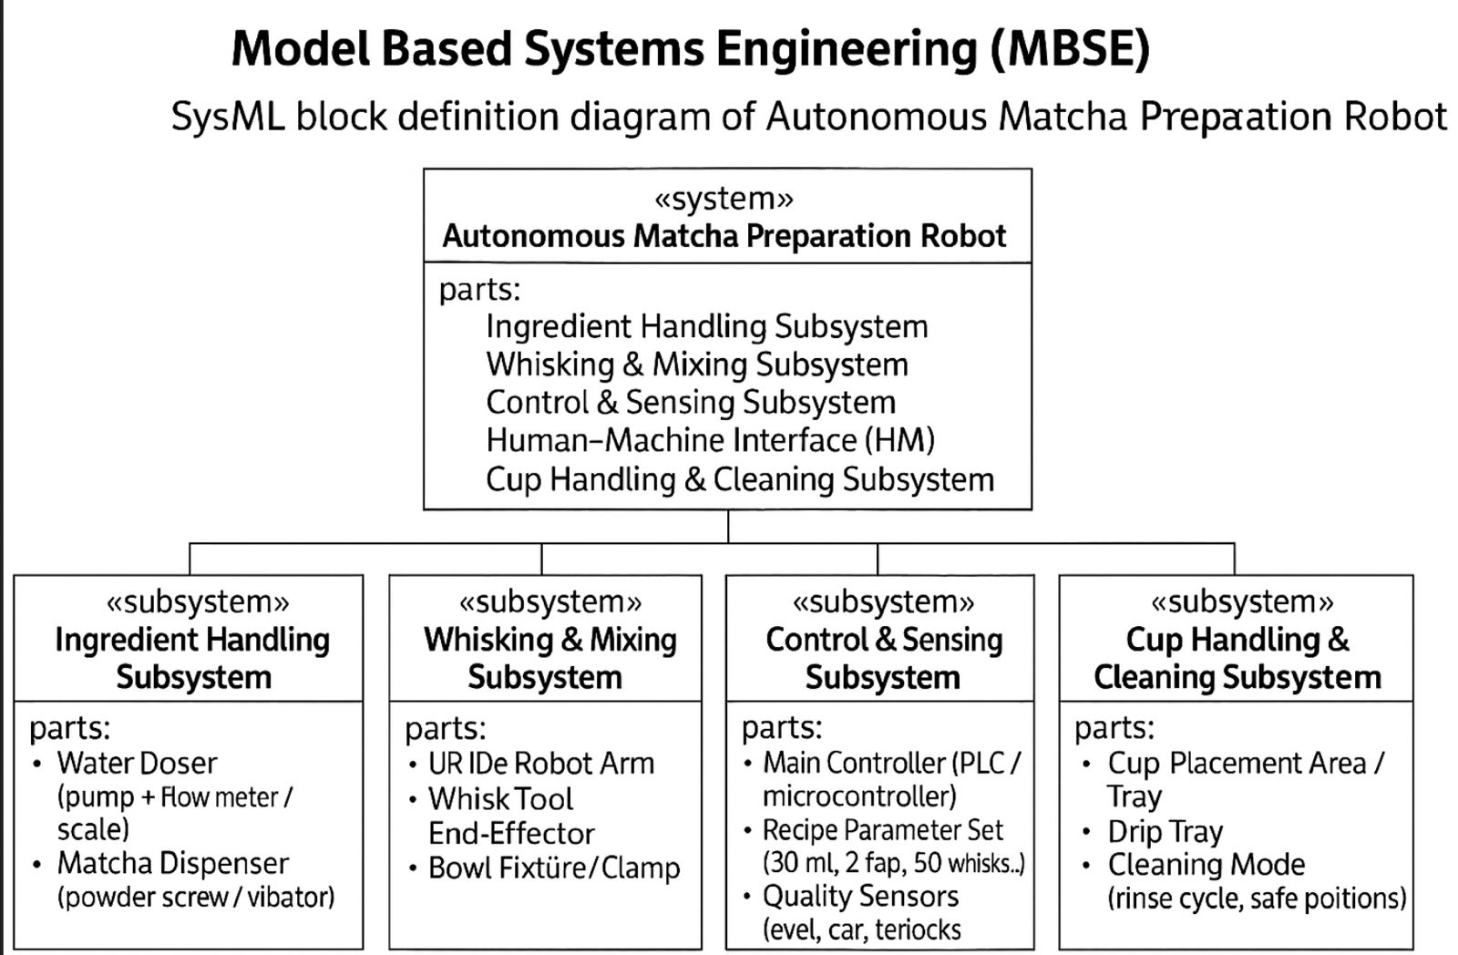
MBSE in the Matcha Robot Project
MBSE = Model-Based Systems Engineering
This SysML Block Definition Diagram (BDD) breaks down the Semi-Automated Matcha Preparation Robot into its major subsystems. It provides a structured architectural view of the entire system, showing how the robot is organized and how responsibilities are allocated across subsystems.
Human Interaction Subsystem – Human adds matcha, places the bowl, and checks final quality.
Whisking & Mixing Subsystem – UR10e robot arm with whisk end-effector mixes the matcha consistently.
Control & Sensing Subsystem – Main controller runs the recipe (30 ml water, 50 whisks) and monitors sensors such as bowl presence and flow.
Cup Handling & Cleaning Subsystem – Human cleans the bowl , bowl placement area and cleaning routines.
Together, these subsystems create a clear MBSE structural model showing how the robot and human roles integrate to produce reliable, consistent matcha.

Slide 13
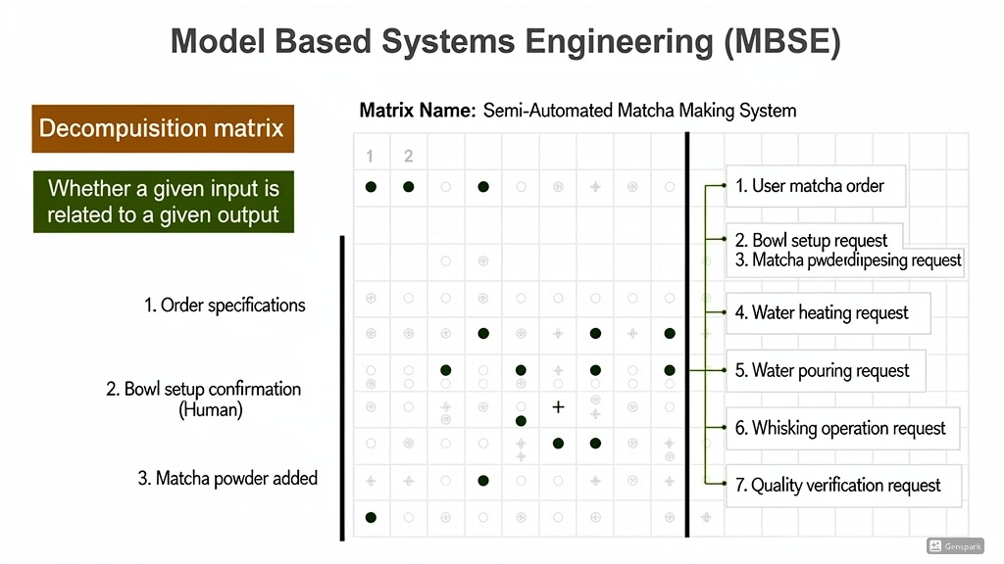
MBSE: Design Structure Matrix Analysis
This decomposition matrix shows how inputs to the matcha-making system influence the outputs (system actions). It is an MBSE tool used to understand system behavior and trace how each input drives specific operations.
Inputs:
Order specifications (user selects matcha)
Bowl setup confirmation (human places bowl correctly)
Matcha powder added (human adds matcha)
Outputs:
Matcha order processing
Bowl setup request
Powder-related actions
Water pouring
Whisking operation
Quality verification
What the dots mean:
A dot (●) indicates that the input directly influences that output.
This helps identify the sequence of operations and ensures no step is missed.
Overall, the matrix clarifies the logical flow of operations, ensuring the robot only performs actions when the required human inputs are complete.

Slide 14
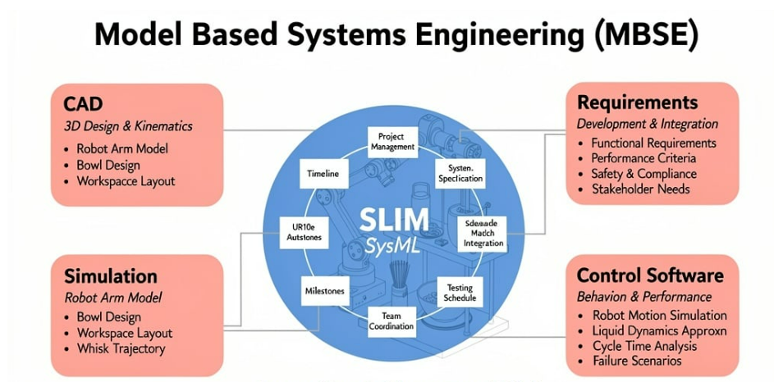
MBSE: Design Structure Matrix Analysis
This diagram shows how Model-Based Systems Engineering (MBSE) integrates all major elements of a system through SLIM (System Lifecycle Management). The central SysML model connects every discipline involved in developing the matcha-making robot.
Key Components:
CAD – Designs the robot arm, bowl, and workspace layout.
Simulation – Models robot motion, workspace interactions, and whisk trajectories.
Requirements – Defines functional needs, performance criteria, safety, and stakeholder expectations.
Control Software – Handles robot motion simulation, liquid dynamics, cycle-time analysis, and failure scenarios.
What the image shows:
SLIM unifies design, simulation, requirements, and control into one integrated system model, ensuring consistency, better decision-making, and efficient development using MBSE principles.

Slide 15
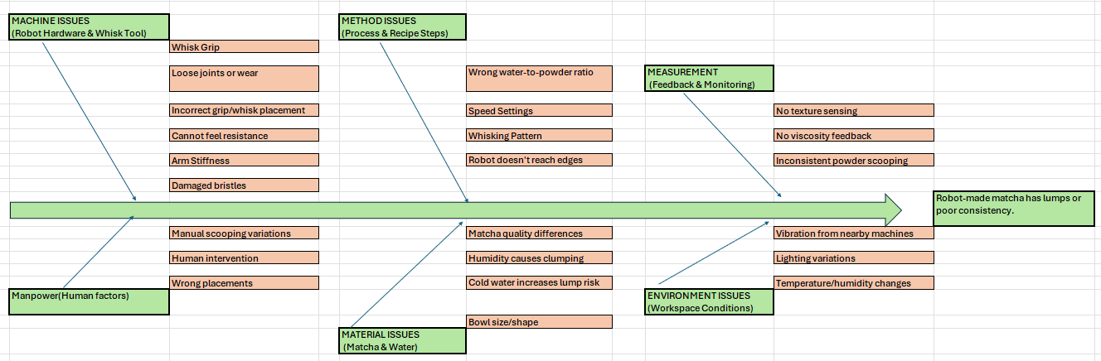
FISHBONE ANALYSIS

Slide 16
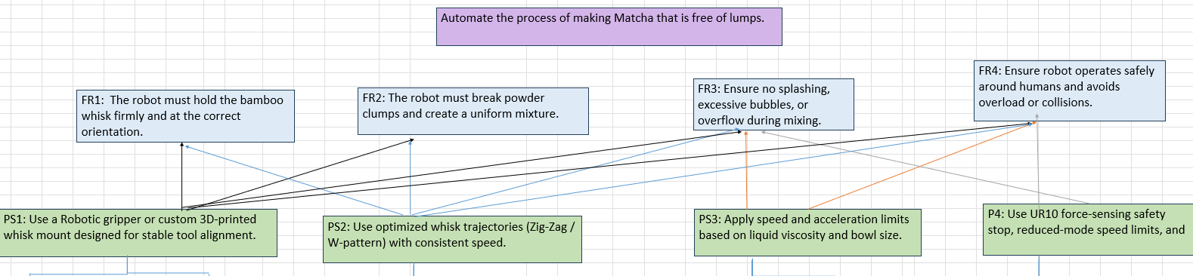
AXIOMATIC DESIGN Level 1

Slide 17
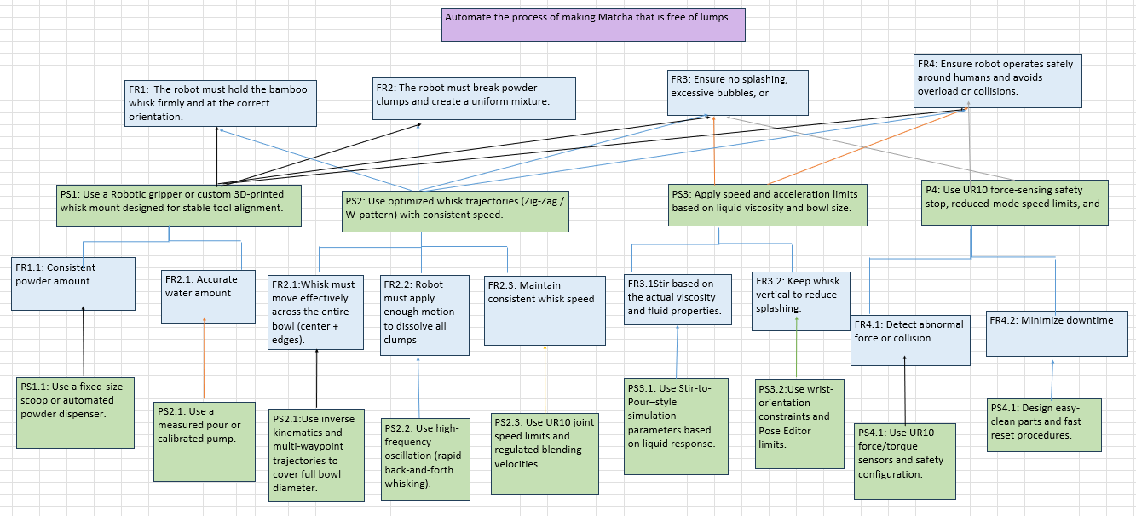
AXIOMATIC DESIGN Level 2

Slide 18
Fault Tree Analysis

Slide 19
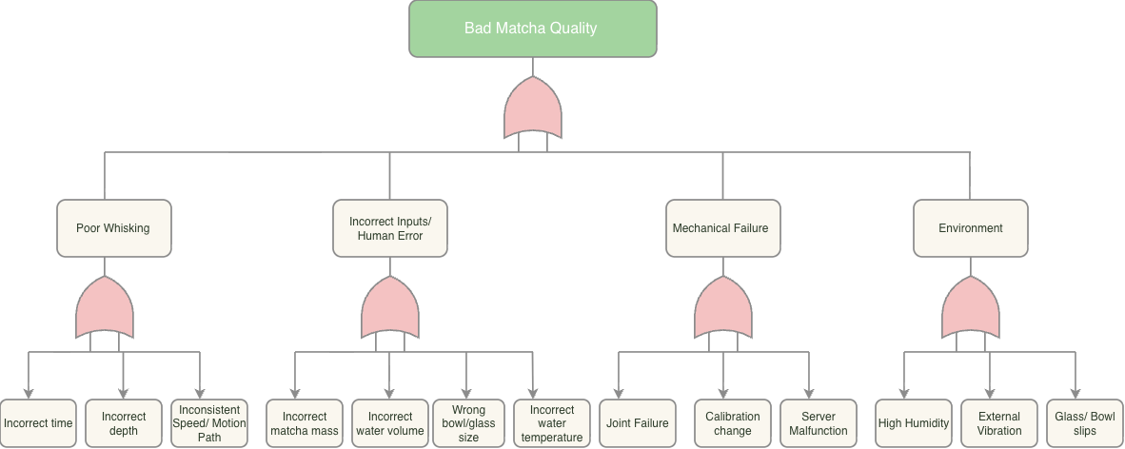
Fault Tree Analysis

Slide 20
Linear Programming

Slide 21
Optimize Linear Program
What if we had a cafe with both humans and robots?
Who would make more coffee/matcha ? Human ? Robot?
Can we minimize the total time required by both humans and robots to produce all cups of coffee?
Goal - To decide how many cups should be made by human and how many by robot.

Slide 22
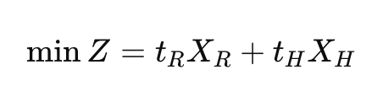
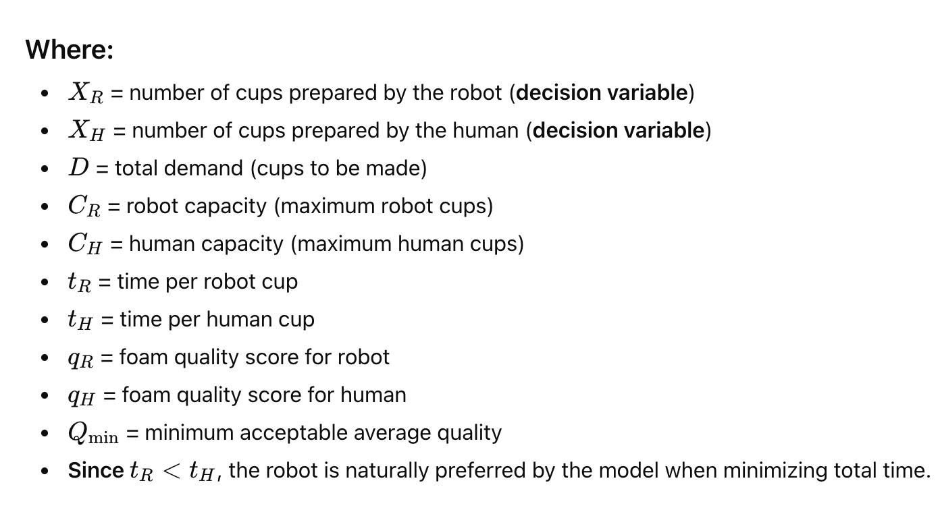

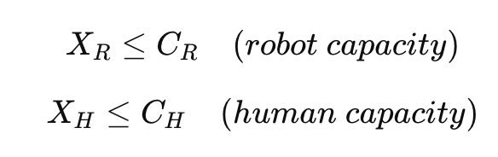
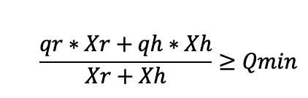

Optimize Linear Program
Objective Function
Demand Constraints
Capacity Constraints
Quality Constraints
Non - negative

Slide 23
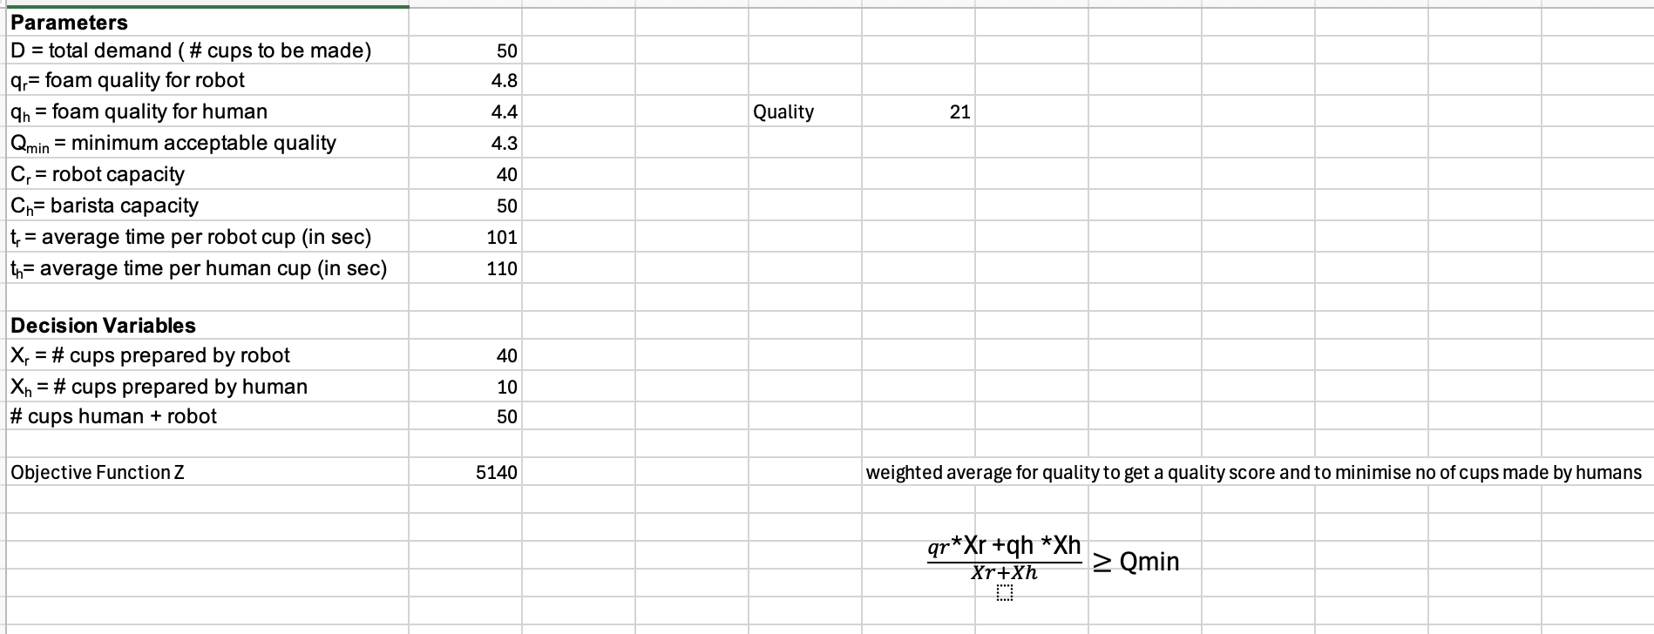
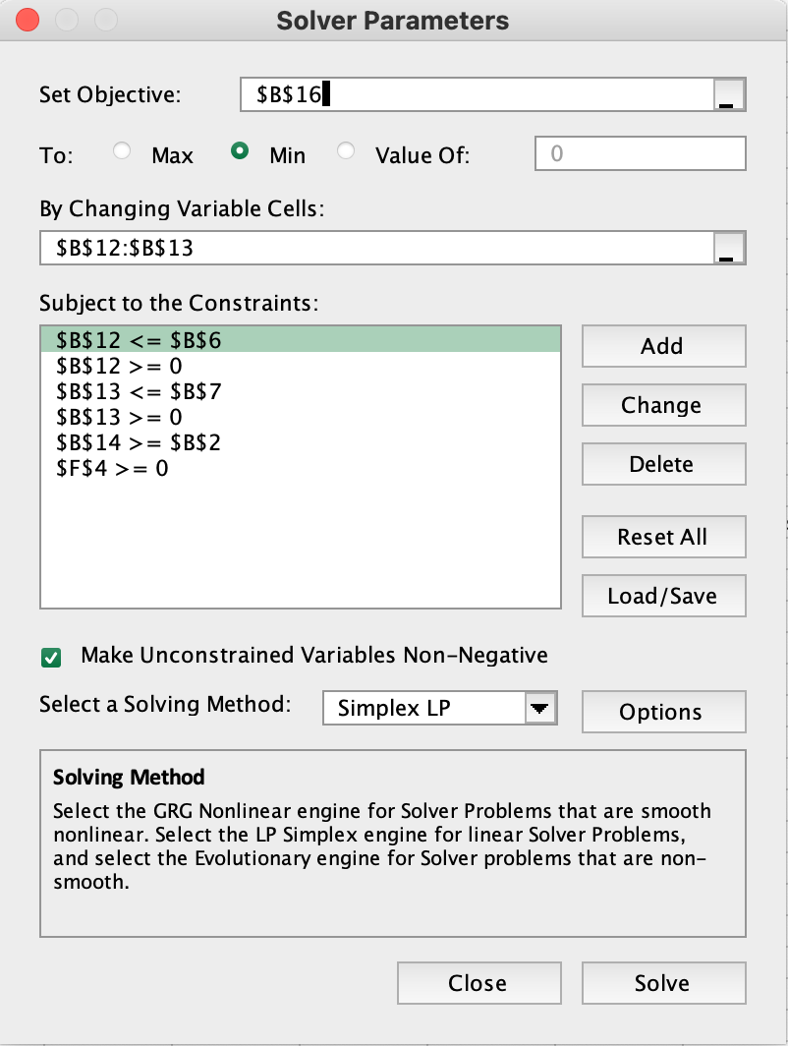
Optimize Linear Program

Slide 24
LTV , CAC and FMEA

Slide 25
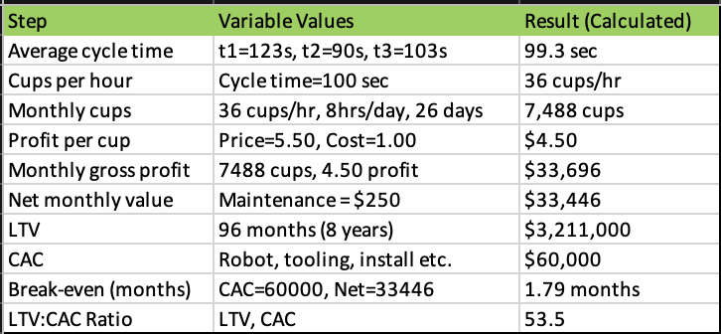
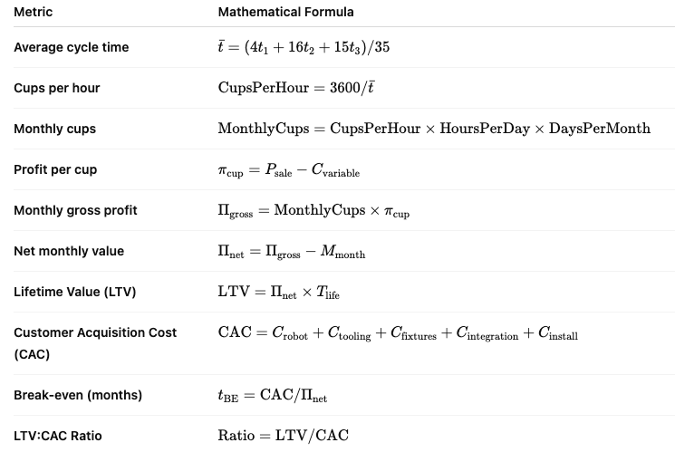
LTV and CAC

Slide 26
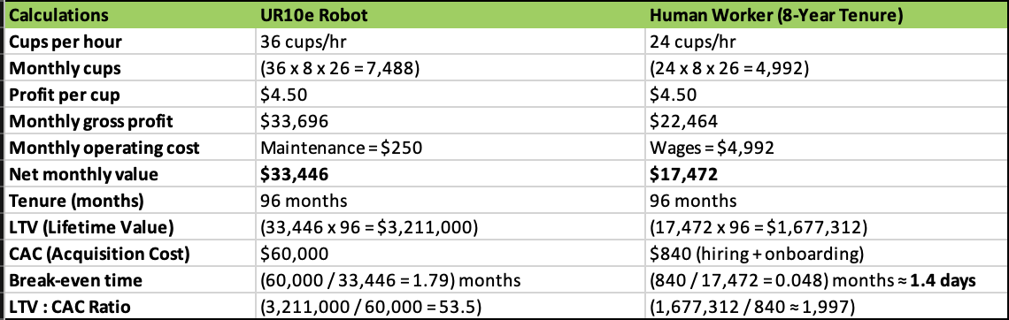
LTV and CAC

Slide 27
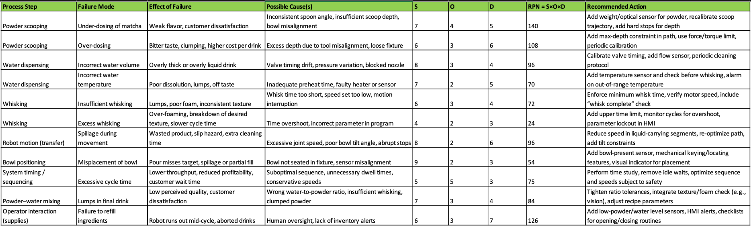
FMEA
S (Severity): 1 = negligible, 10 = catastrophic
O (Occurrence): 1 = rare, 10 = happens almost every cycle
D (Detection): 1 = easy to detect before reaching customer, 10 = very hard to detect
RPN=S×O×D
High RPN → good candidate for design or process improvement.

Slide 28
Reliability, Maintainability and Queueing

Slide 29
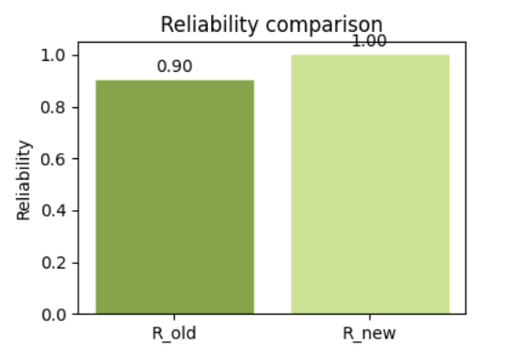
Reliability
Our mission is making one cup of matcha
Calculation
Ran 31 labelled robot trials with different recipes.
3 out of 31 cups were lumpy, so the probability of a good cup is:
R(old)=(31−3)/31≈0.90.
So the baseline reliability of the system is about 90% per cup.
Robust recipe region
Best recipe region (30 ml water, 2 tsp matcha), we got: 5 perfect cups out of 5 runs.
In that region, the observed reliability is
Rnew≈1.0(no failures in our data).
Lock the best recipe , we move from ~90% to almost 100% reliability.
Matcha Quantity
Water Quantity
UR10e Whisking Action
Cup Output

Slide 30
Maintainability
How quickly can we recover?
Treat each lumpy cup as a failure that triggers corrective maintenance (clean + remake).
Failures = 3, total labeled cups = 3
MTBF (in cups) ≈ 31 / 3 ≈ 10.3 cups per failure
Mean service time ≈ 1.65 min → assume MTTR ≈ 1.65 min
Use: A ≈ MTBF / (MTBF + MTTR)
Here: A ≈ 10.3 / (10.3 + 1.65) ≈ 0.86
So availability of the robot barista is about 86% in our current mixed-recipe mode.
How We Improve MTBF & Availability?
Ban high-risk recipe → remove 20 ml, 3 tsp combo from allowed settings.
Design for easy cleaning of whisk/bowl → reduces MTTR for each failure.
Add controller guardrails against bad parameter combinations.
Scenario | MTBF (cups) | MTTR (min) | Availability A
Current (all recipes mixed) | 10.3 | 1.65 | 0.86
After recipe guardrail (20,3 off) | >10.3 | 1.65 | ≈1.0 (conceptual)

Slide 31

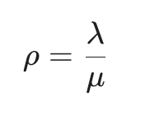
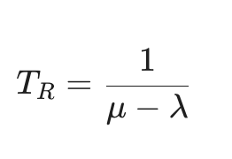
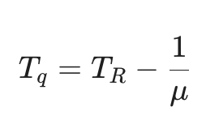
Queueing
What happens when many people order at once?
Total time as service time:
Robust recipe (30ml, 2 tsp): average service time ≈ 1.73 min
Service rate:
μ(robust)≈1/1.73≈0.58≈0.58 cups/min
Model: M/M/1 queue (People arrivals λ, one robot server μ)
Interpretation
At λ = 0.3, average wait is under 2 minutes; at λ = 0.5, average wait jumps to ~11 minutes because utilization is ~86%.
Reliability | Impact on Queueing & Service
Fewer Failures | Fewer remakes ->effective stays high
Higher Availability | Robot serves more time serving, less time down
Stable service time | More predictive waiting time ( T_q)
Key Formulas
Arrival rate λ (cups/min) | Utilization ρ = λ/μ | Avg time in system T_r (min) | Avg waiting time T_q (min)
0.30 | 0.52 | 3.57 | 1.85
0.40 | 0.69 | 5.56 | 3.83
0.50 | 0.86 | 12.50 | 10.78

Slide 32
Conclusion
Why the system is less human-dependent now?
Recipe is encoded, not remembered – the “good region” (30 ml, 2 tsp, 50 whisks) lives in the controller, not in the barista’s head.
Guardrails block bad choices : Software prevents high-risk parameter combos (e.g., 20 ml / 3 tsp), so a tired operator can’t accidentally choose them.
Consistency is measured by process, not by human judgment : same quantities and whisking trajectory every time → reliability comes from the robot, not from an expert’s “feel.”
Standardized sequence : UR10e runs the same motion and timing each cup, so quality and service time no longer depend on who is operating the system.

Slide 33
Future Work
Technical Work
Closed-loop quality control (CV + sensors)
Bayesian optimization for full recipe and motion
Task and Motion Planning for full drink workflow
Reliability growth and predictive maintenance.
Human factors and UX
User acceptance studies for robot barista
Personalized Matcha Profiles
Compare Human vs Robot Reproducibility
Operations and Business
Multi Robot Queueing Model
Live LTC/CAC experiments
Cleaning Safety and Standards Integration

Slide 34
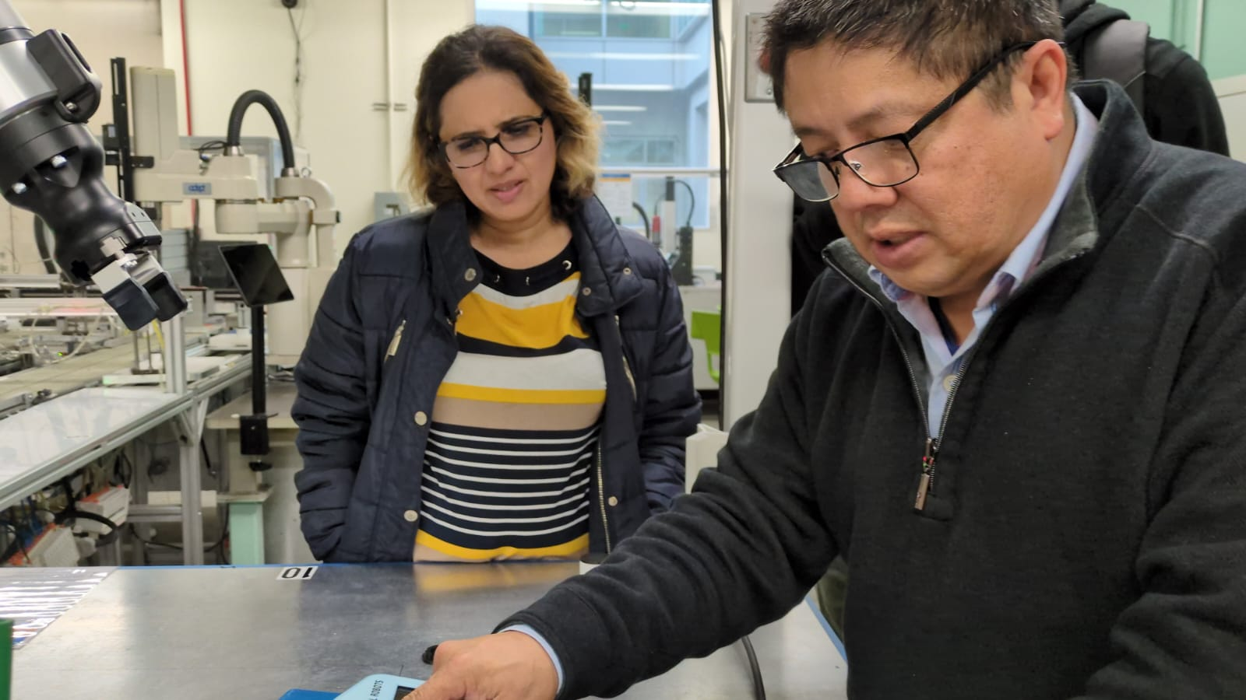
Thank You
Special thanks to Dr Behin Elahi and Prof Tom Pham

